Slide 1

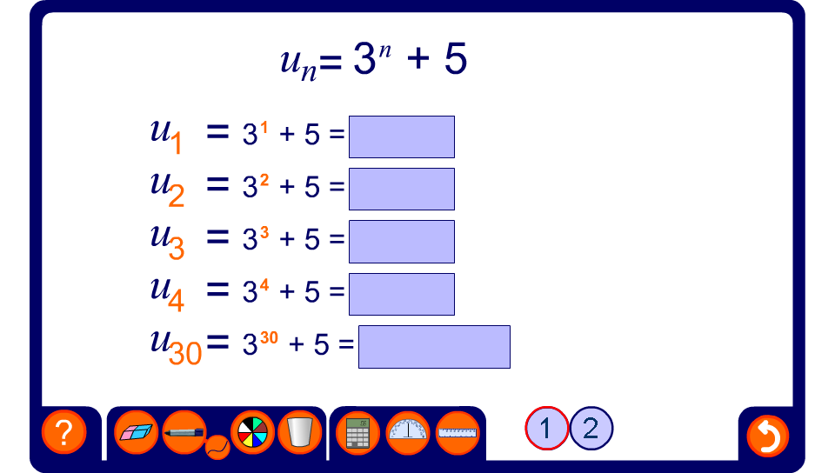


Writing sequences from position-to-term rules
Notes:
Ask pupils to calculate the value of each term using substitution. Calculators may be used for more difficult examples.
If the example shown is of a form you don’t want, press the reset button for another example.

